Slide 1



Delving in to Blockchain
Sriram
Technology of Trust

Slide 2

Course Objectives
After completing this module, you should be able to:
Understand different types of networks
Cryptocurrency and its growth
Explain Blockchain and its uses
Grasp the components of a Blockchain ecosystem
Induce the structure and mechanisms of a Blockchain
Deduce various cryptography and consensus algorithm
Fathom different types of Blockchain
Infer various types of Blockchain platforms
Key Concepts in Blockchain
Bitcoin and its usage

Slide 3


Types of Blockchain

Slide 4


Blockchain Types
Public: In a public Blockchain, ledgers are visible to everyone on the internet and anyone can verify and add a block of transactions to the Blockchain.
Examples – Bitcoin, Ethereum, Dash, Factom
Private: Private Blockchains allow only specific people in the organization to verify and add transaction blocks since all permissions are kept centralized to an organization, but everyone on the internet is generally allowed to view. Examples- Multichain, Blockstack
Consortium: Is controlled by a consortium of members and only a predefined set of nodes have access to write the data or block.
Examples- Ripple ,R3 & Hyperledger1.0
Public
Private
Consortium
Blockchain Types

Slide 5
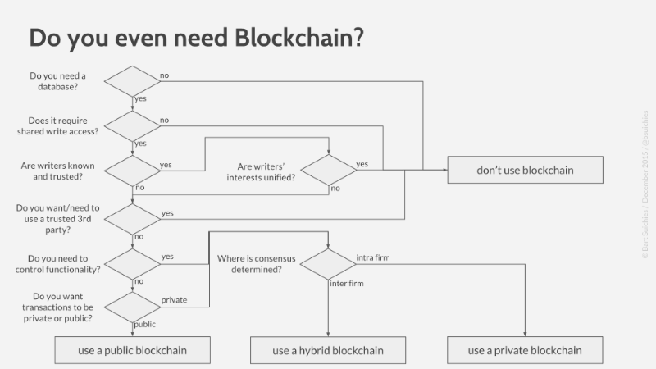

Do you even need Blockchain?
Identify, if you actually need the benefits of a distributed ledger or not, chances are you probably don’t need it!
To building our application around the open-source Ethereum Blockchain application platform the following points to be considered:-
It’s open source with a strong community behind it
Good support for Smart Contracts via Solidity (a programming language for smart contracts)
The APIs are pretty well documented and there are a range of API clients in different languages
There are a bunch of tools, compilers, libraries etc. already out there to help with development

Slide 6
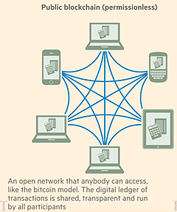
Public Blockchain
Protocols - Proof of Work (PoW) consensus algorithms
Anyone can
Participate without permission
Download the code
Start running a public node on their local device
Validating transactions in the network
Can send transactions through the network
Read transaction on the public block explorer
Example: Bitcoin, Ethereum, Monero, Dash, Litecoin, Dodgecoin, etc.,
Effects :
Potential to disrupt current business models through disintermediation
No infrastructure costs: No need to maintain servers or system admins radically reduces the costs of creating and running decentralized applications (dApps).

Slide 7
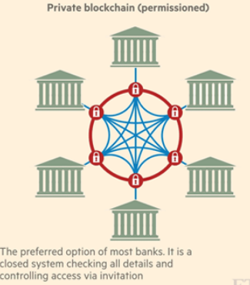
Private Blockchain
Only specific, pre-chosen entities have the ability to create new transactions on the chain
Closed network
Write permissions are kept centralized to 1 organization
Read permissions may be public / restricted to an arbitrary extent (database management, auditing, etc.,)
Setting up groups and participants who can verify transactions internally
Not so secured like public Blockchain
Example: MONAX, Multichain
Effects :
Reduces transaction costs and data redundancies and replaces legacy systems
Internal to single / group of company and organizations

Slide 8
Consortium / Federated Blockchain
Federated Blockchain operate under the leadership of a group
Federated Blockchain are faster (higher scalability) and provide more transaction privacy.
Consortium Blockchain are mostly used in the banking sector
The consensus process is controlled by a pre-selected set of nodes
for example, one might imagine a consortium of 15 financial institutions, each of which operates a node and of which 10 must sign every block in order for the block to be valid. The right to read the Blockchain may be public, or restricted to the participants.
Right to read the Blockchain may be public, or restricted to the participants.
Example: R3 (Banks), EWF (Energy), B3i (Insurance), Corda
Effects:
Reduces transaction costs and data redundancies and replaces legacy systems
Internal to single / group of company and organizations

Slide 9

Public Vs Private Blockchain
Features | Public | Private
Participation | Anyone can participate | By invitation only, vetted either by a central authority, consensus or other criteria
Access Control | Anyone can read and anyone can write | Read and write access may be restricted to protect privacy of data
Identity | Anonymous / Pseudonymous | Participants identified, preferably strongly i.e., Known Identities
Consensus | Typically requires a majority of validator nodes | May be done by a smaller set of nodes, such as stakeholders and/or knowledge-holders
Control of Code | Anyone can make changes, but a majority of nodes decide which to keep | May be centralized or controlled by a consortium
Speed | Slower | Faster
Security | Proof-of-work | Proof-of-stake | Pre-approved Participants
Asset | Native Assets | Any Asset

Slide 10
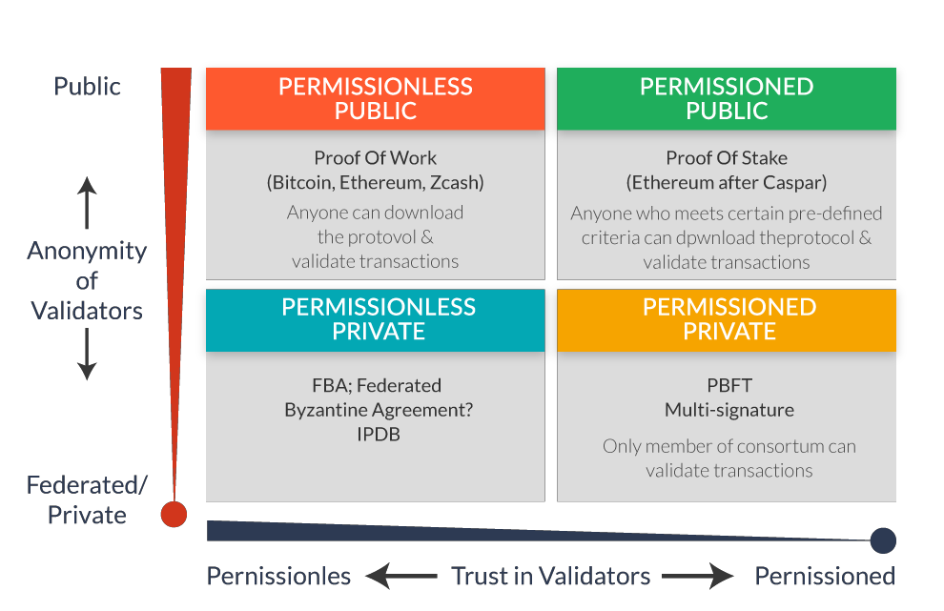
Comparing Public And Private Blockchains
Proof-of-Work
Proof-of-Stake
CASPER)
Anyone can download the protocol and validate transactions
Anyone who meets certain
pre-defined criteria can download the protocol and validate transactions
protocol and
Only members of Consortium can validate transactions
Un-permissioned
Permissioned

Slide 11








Permissioned And Un-permissioned Blockchain
Properly Permissioned Blockchain networks differ from Un-permissioned Blockchain networks solely based on the presence (or absence) of an access control layer built into the Blockchain nodes.
V/S
Since the network is open, anybody can participate and contribute in the consensus
Restricts the actors who can contribute to the consensus of the system state.

Slide 12
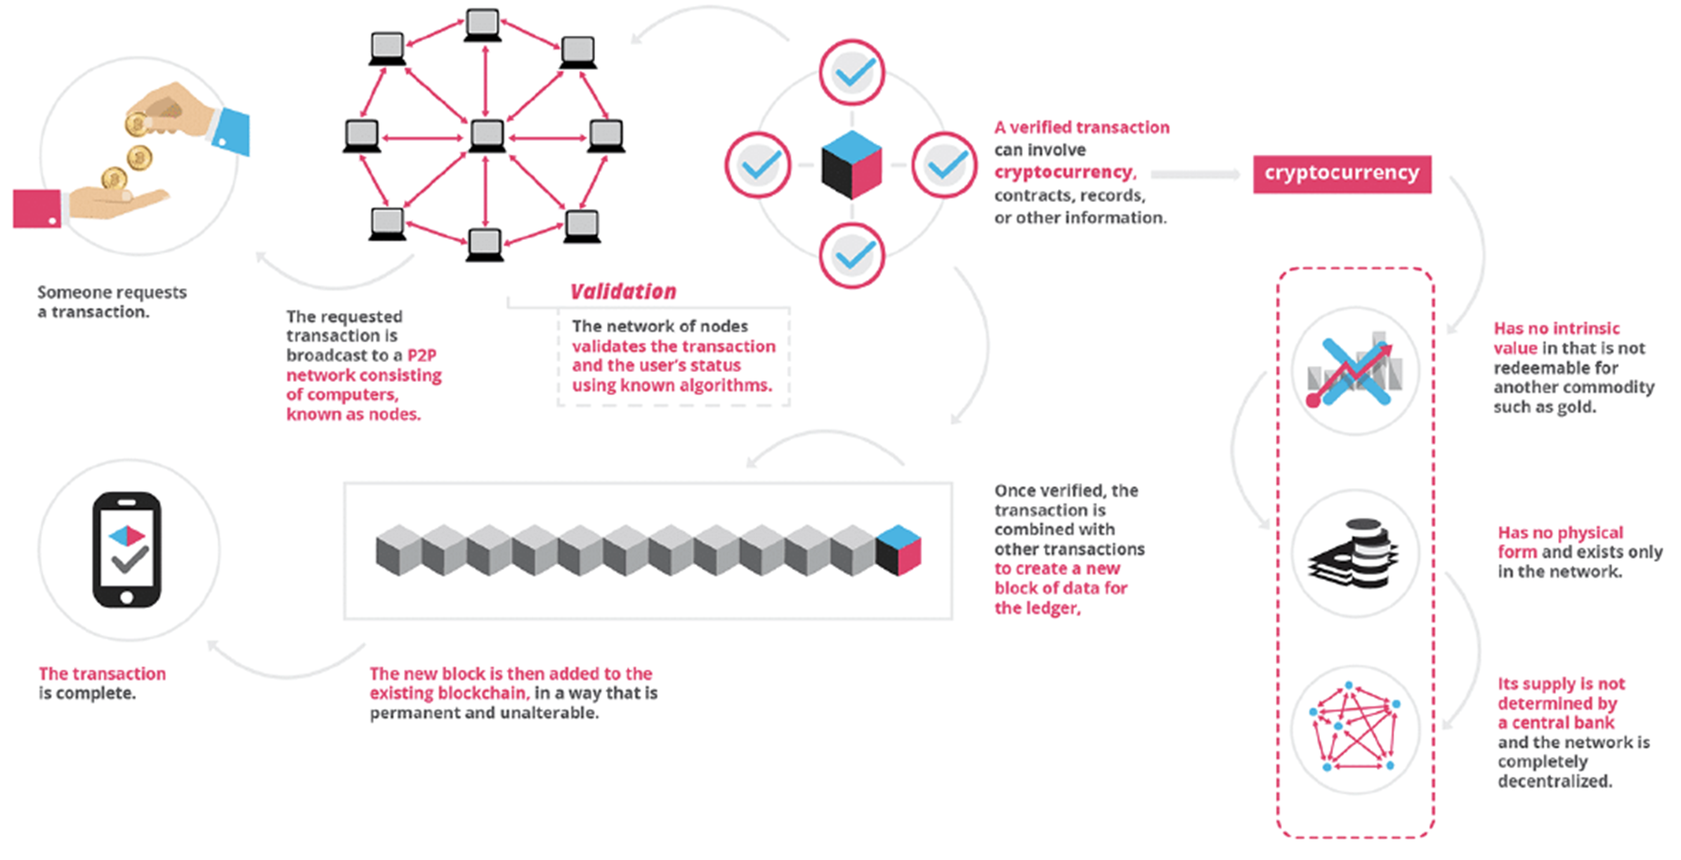
Transaction in Blockchain

Slide 13
Key Concepts in Blockchain

Slide 14

Blockchain Structure

Slide 15



Blocks in Blockchain
Header- Contains version info, nonce, previous block id and time stamp
Merkle- A hash built from the block’s
transaction identifiers
Version Number
Nonce
Previous block hash
Time stamp
Header
Merkle
List of Record’s- Identification hashes that
was included into the block’s Merkle tree
Merkle Tree Hash
Transaction’s Id list
. .
Block
Blockchain
Simplified Block Structure

Slide 16
Structure of the Block Header
Consists of three sets of block metadata
Reference to a previous block hash
The difficulty, timestamp and nonce
The Merkle root
SIZE | FIELD | DESCRIPTION
4 bytes | Version | A version number To track software/protocol upgrades
32 bytes | Previous Hash Block | A reference to the hash of the previous block in the chain
32 bytes | Merkle Root | A hash of the root of the Merkle tree of this block’s records
4 bytes | Timestamp | The approximate creation time of this block
4 bytes | Difficulty target | The proof-of-work algorithm difficulty target of the block
4 bytes | Nonce | A counter used for proof-of-work algorithm

Slide 17
Block Identifiers: Block Header Hash & Block Height
Block Header Hash
Block Height
The primary identifier of a block is its cryptographic hash
A digital fingerprint, made by hashing the block header twice resulting 32-byte hash
The block hash identifies a block uniquely
The block hash is not included inside the block’s data
structure
It is the position of the block in the blockchain
The first ever block created is at block height zero
Each block added on top has one position higher in the blockchain
It is also not a part of the block’s data structure
Each node dynamically identifies a block’s height in the
blockchain

Slide 18
Hash Functions & Merkle Trees

Slide 19



Hash Function
Hashing is a mathematical process that takes input data of any size, performs an operation on it and returns string of random letters and numbers of fixed size.
Hash Function is a programmatically developed method, which perform the hashing.
Example of Hashing : a0680c04c4eb53884be77b4e10677f2b
Message Digest or Digital Fingerprint

Slide 20
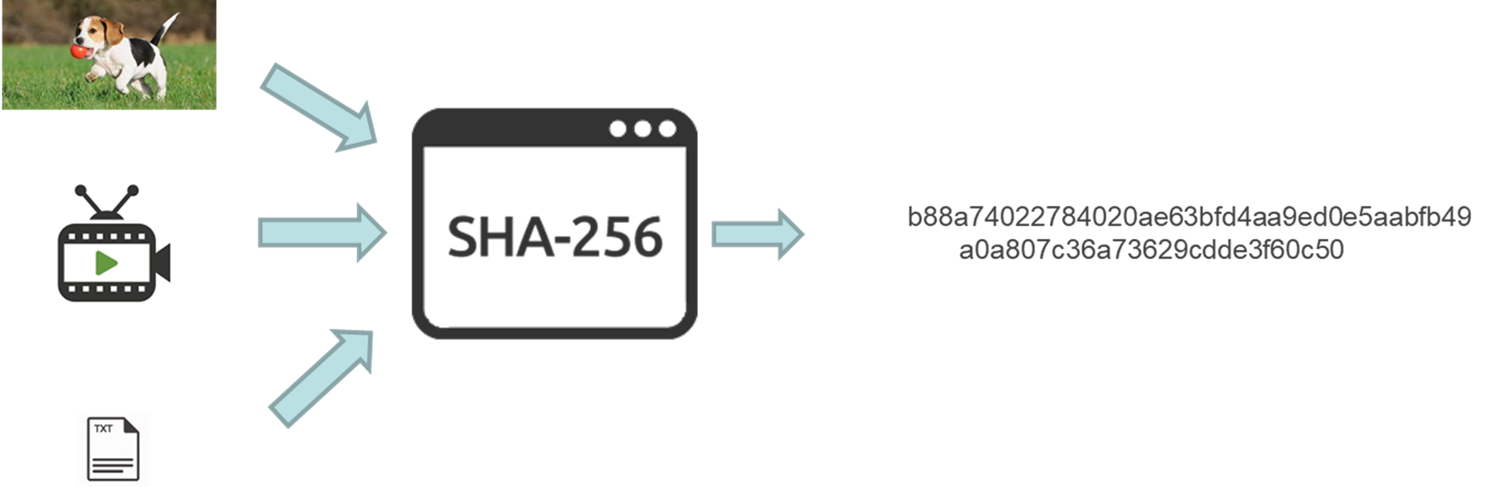
Hash Function..
Electronic equivalent of digital item
SHA256 hashing algorithm – returns 256-bit (32-byte) signature – Length 64 Char.
(256 bits / 4 bits per char = 64 char
You must be expecting base-16 (AKA hexadecimal) which is 4 bits per character (2^4 = 16).)
For any input (Image, Movie, or text file), hashing gives an unique irreversible fixed length identifier (32 bytes) as output.
URL: https://passwordsgenerator.net/sha256-hash-generator/

Slide 21
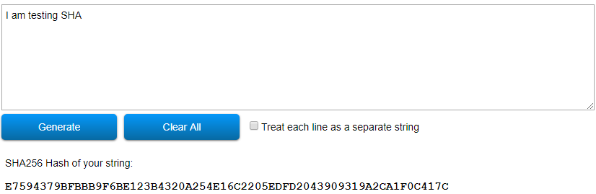
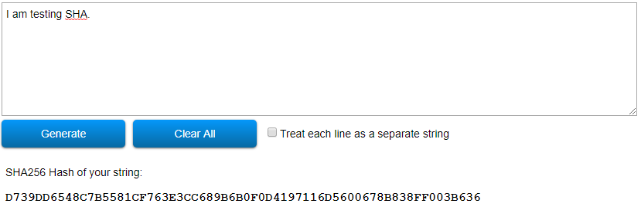
Hash Function..
URL: https://passwordsgenerator.net/sha256-hash-generator/

Slide 22









Properties Of Hash Functions
Deterministic
The same input always produces the same output. Small changes in the input results in a dramatic changes in the output.
01
Quick Computation
02
They are quick to compute
Cannot be Reverse-Engineered
They are one-way functions. That is, it is extremely difficult to determine an input if you are given the output
03
Collision Resistant
Given two different inputs A and B and their respective hashes, it is infeasible for both the Hash values are to be equal.
04

Slide 23
Examples Of Cryptographic Hash Functions
MD5
Produces a 128-bit Hash, Collision resistance was broken after ~2^21
hashes
.
SHA1
Produces a 160-bit hash. Collision resistance broke after ~2^61 hashes
SHA256
Produces a 256-bit hash. This is currently being used by Bitcoin
01
02
Keccak256
Produces a 256-bit hash and is currently used by Ethereum
03
04

Slide 24
Advantages Of A Merkle Tree
Easy to check if the transactions have been tampered with
01
Easy to verify if a specific transaction has been added to a block or not
02
Uses fewer resources
03

Slide 25
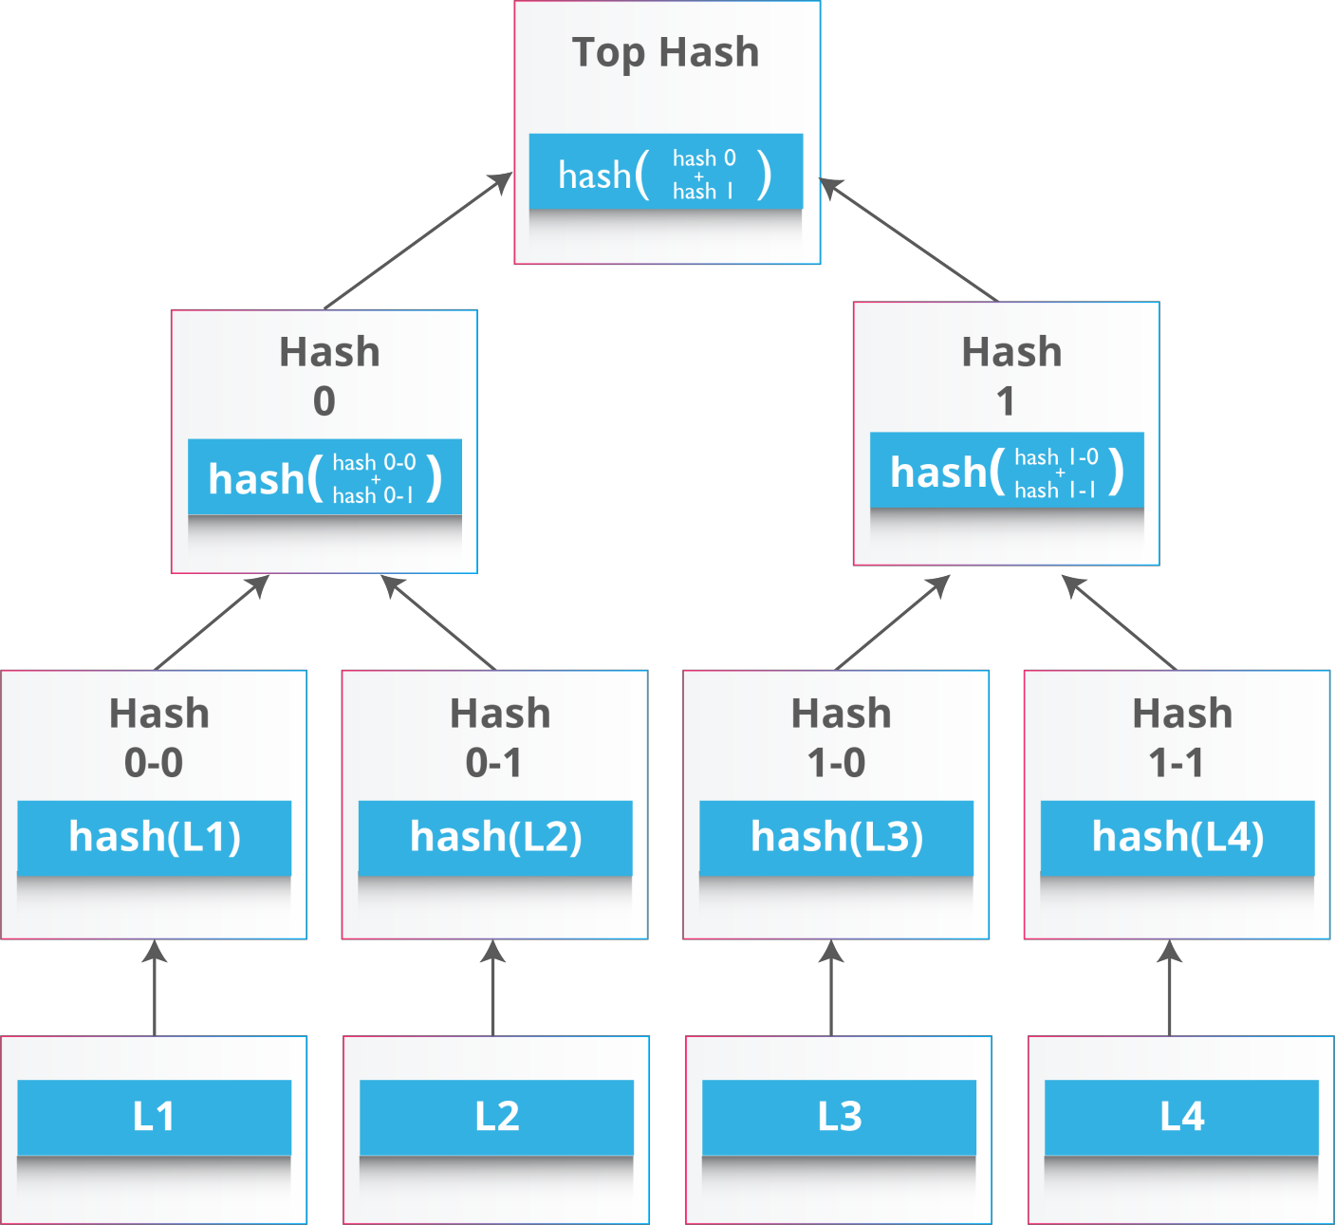
Merkle Trees
Also known as Binary Hash Tree
A data structure used for summarizing and verifying the integrity of large sets of data
It contains cryptographic hashes
Displayed upside down with the root at top and the
leaves at the bottom
A block of one or more new records is collected and such records are then hashed, and the hashes are then paired, hashed, paired again, and hashed again until a single hash remains.
That single hash is called the Merkle root of a merkle tree.

Slide 26
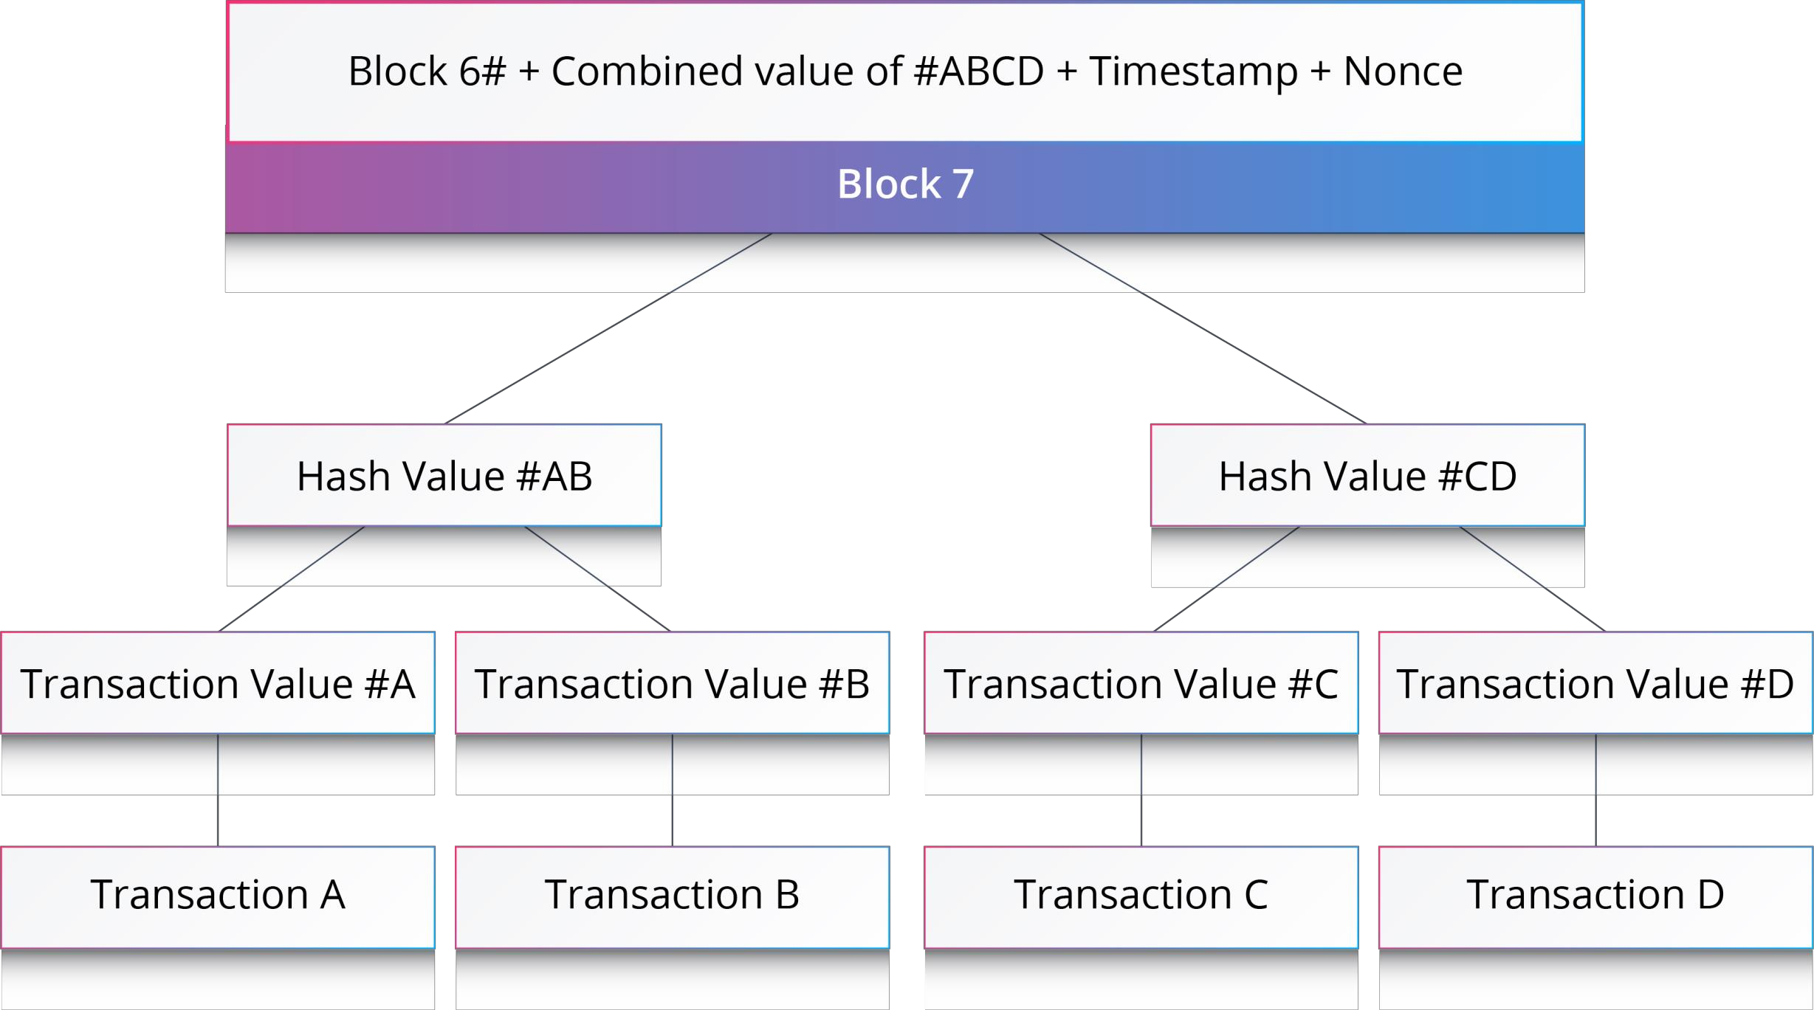


Merkle Tree Of Even Number Of Transactions
0 1 2 3 4 5 6
7
Blockchain
In the example shown:
The merkle tree consists of even number of transactions

Slide 27
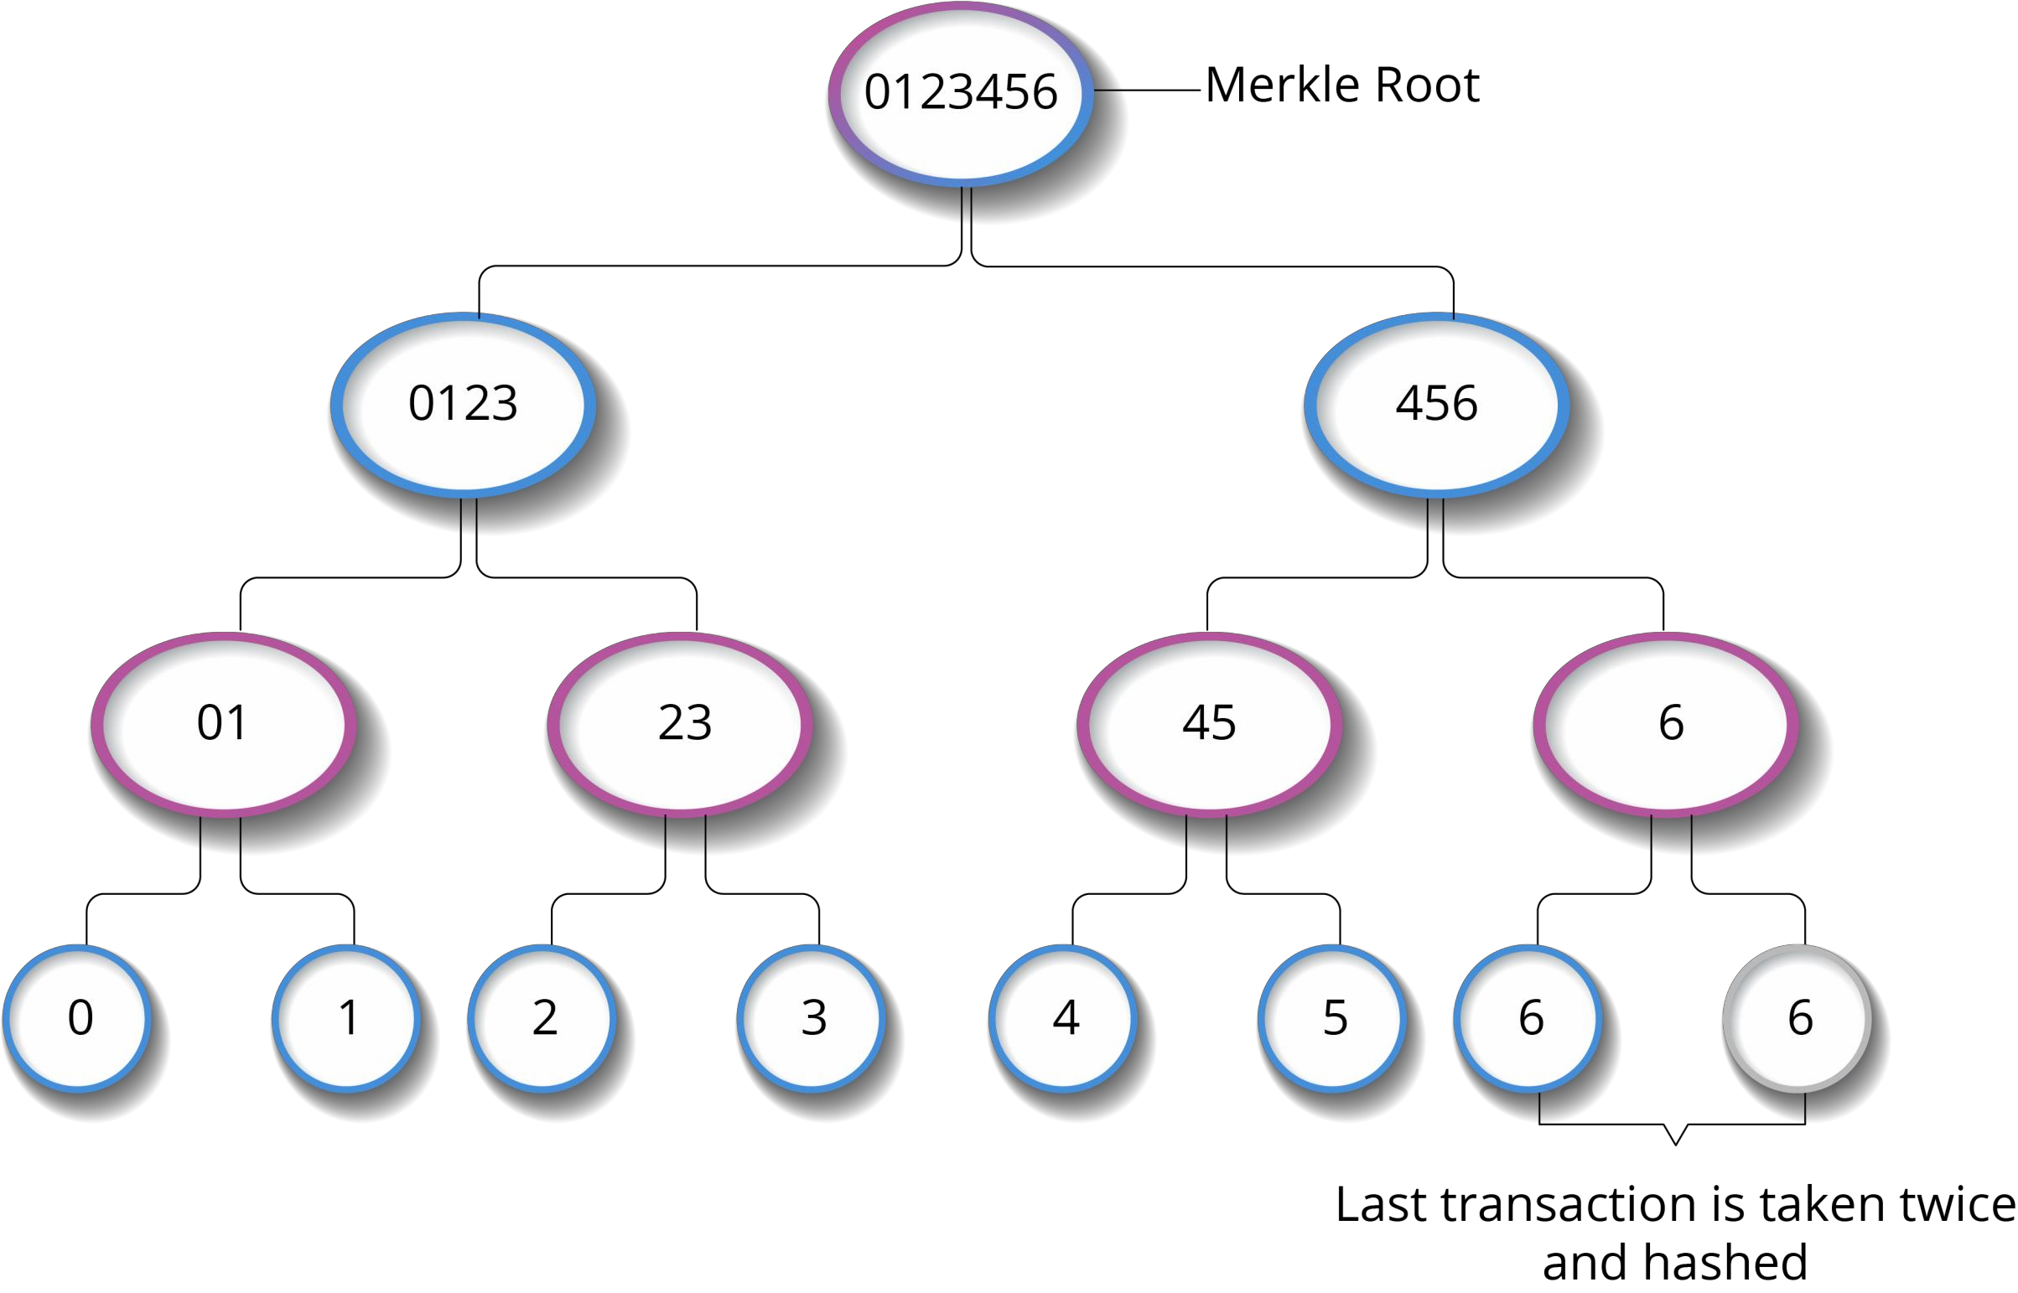
Merkle Trees Of Odd Number Of Transactions
Let’s suppose there are odd number of
transactions in a block.
In this case, the last transaction is hashed with itself.
Refer the shown infographic

Slide 28
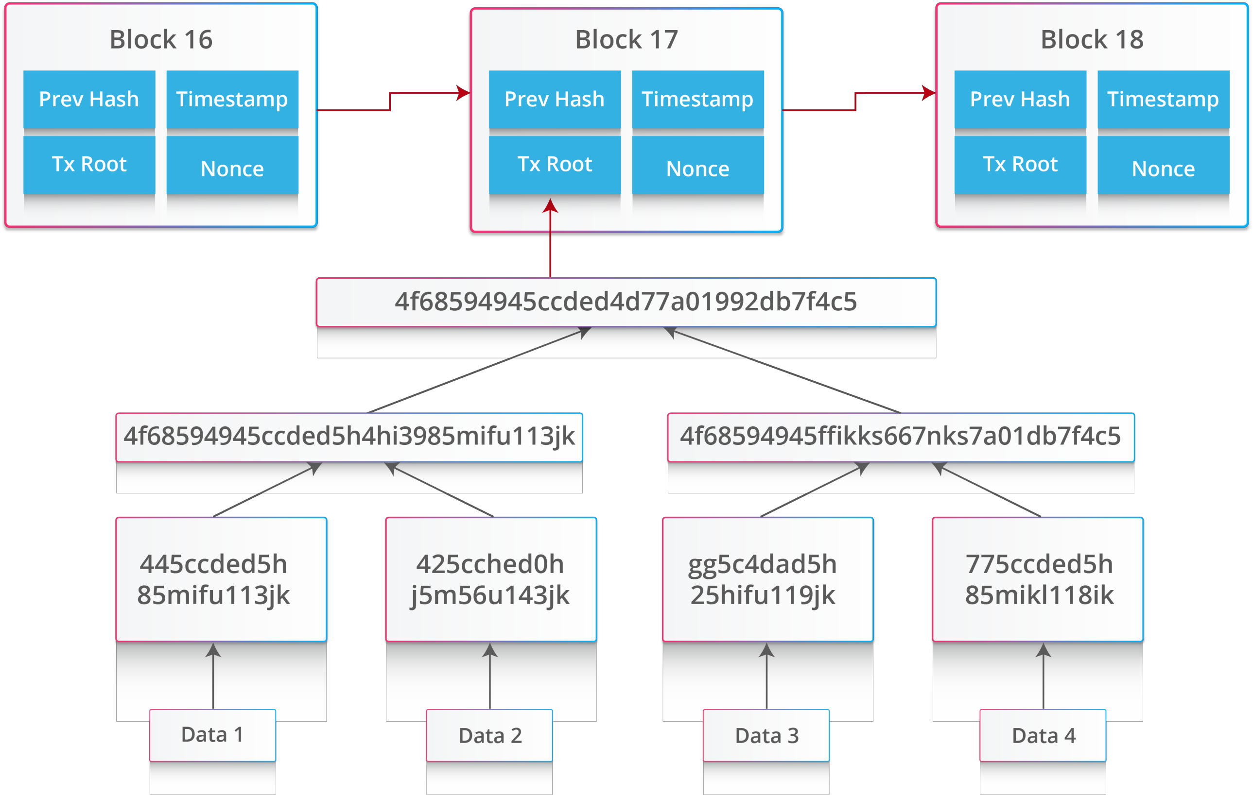
Merkle Tree
Merkle Root
Block
Merkle Tree

Slide 29
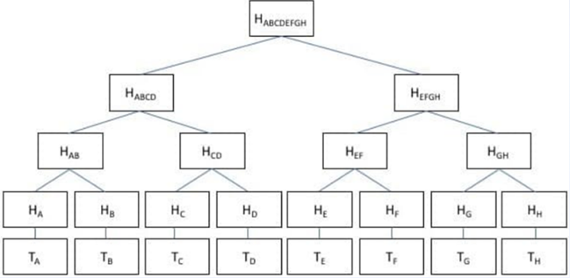
Example: Merkle Tree and Root
T_{A} représentes a normal transaction
Transactions are hashed individually to give their corresponding hash value. T_{A} - H_{A}
Hashing done using SHA-256 hash function
Hashing is repeated for hashed values H_{A,} H_{B} to get H_{AB}
Merkle root – H_{ABCDEFGH}
Process is repeated until the last hash value is obtained
32 bytes in size and is then taken to be placed inside the block header
Represents a summary of all transaction data

Slide 30
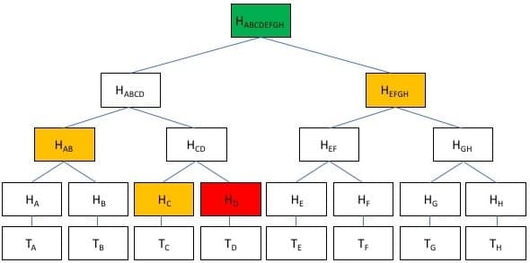
Example: Merkle Tree and Root
Verifying a transaction
Easy to check if transactions have been tampered (or) not
Uses fewer resources
Easy to verify if a specific transaction is altered
For E.g., If we want to check that the transaction T_{D} is altered or not
Hash the T_{D}
You have the hash of T_{C}. i.e., H_{C}. Calculate hash of H_{C and} H_{D} i.e., H_{CD}
You have the hash H_{AB} and H_{CD}. Calculate hash i.e., H_{ABCD}
You have the hash H_{ABCB} and H_{EFGH}. Calculate hash i.e., H_{ABCDEFGH}
If the hash H_{ABCDEFGH} matches with your calculated value then the transaction TD is not altered.

Slide 31
Example: Merkle Tree and Root
Tamper Proof
Straightforward to verify that no transaction in a block has been tampered with
For example - if the transaction: “T_{H}” were to be changed “T_{XYZ}”, the corresponding hash value would be different
This leads to a completely different merkle root, and therefore, it can concluded that if the merkle root were ever to change, one or more transactions must have been tampered.
Advantages
Easy to check if transactions have been tampered with
Uses fewer resources
Easy to verify if a specific transaction has been added to the block

Slide 32
Public & Private Key

Slide 33
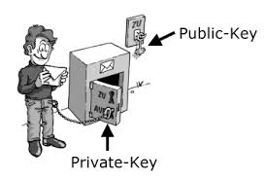
Public & Private Key
Generation of Public and Private Key
Public key is obtained by subjecting a private key to a set of mathematical operations defined in a set of standards known as Elliptic Curve Cryptography (ECC)
Bitcoin private key is simply an integer between one and about 10⁷⁷
Each of these steps in generating the key pair is irreversible
Public Key (E.g. Email id)
Private Key (E.g. outlook client password)

Slide 34
Public & Private Key
Can we generate same key pair for 2nd time ?
In other words, Can I generate the same key of my friend’s key pair ?
Theoretically Yes, Statistically No
Roughly the total number of private keys are equal to the number of hydrogen atoms in the observable universe
A Bitcoin private key is simply an integer between one and about 10⁷⁷
Each of these steps in generating the key pair is irreversible
If you could process one trillion private keys per second, it would take more than one million times the age of the universe to count them all. Even worse, just enumerating these keys would consume more than the total energy output of the sun for 32 years.
Bitcoin’s entire security model rests on the infeasibility of mapping this vast keyspace.

Slide 35
Digital Signature Signing & Verification

Slide 36
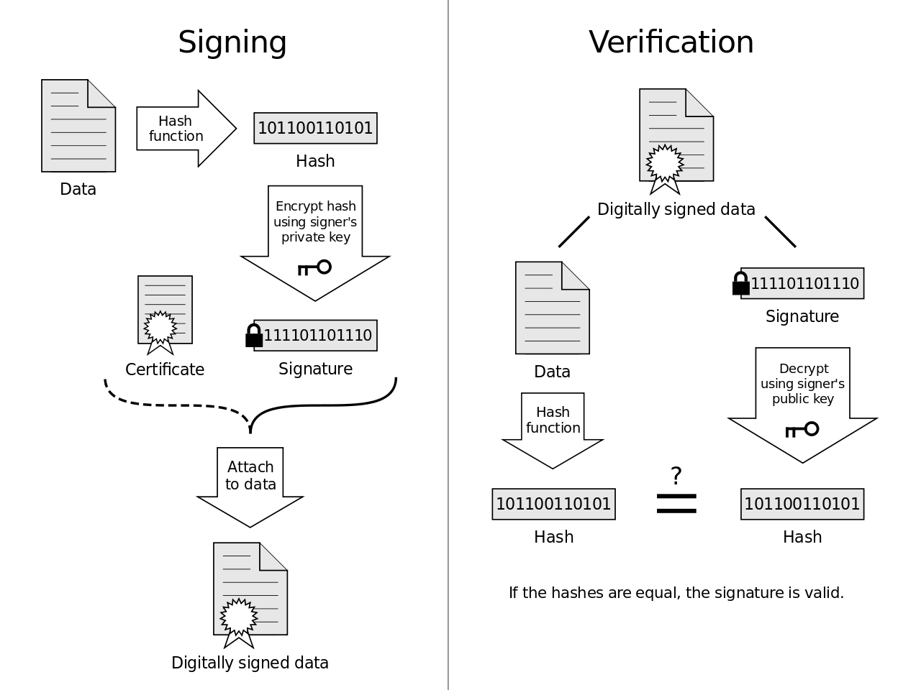
Digital Signature Signing & Verification

Slide 37
Mining

Slide 38
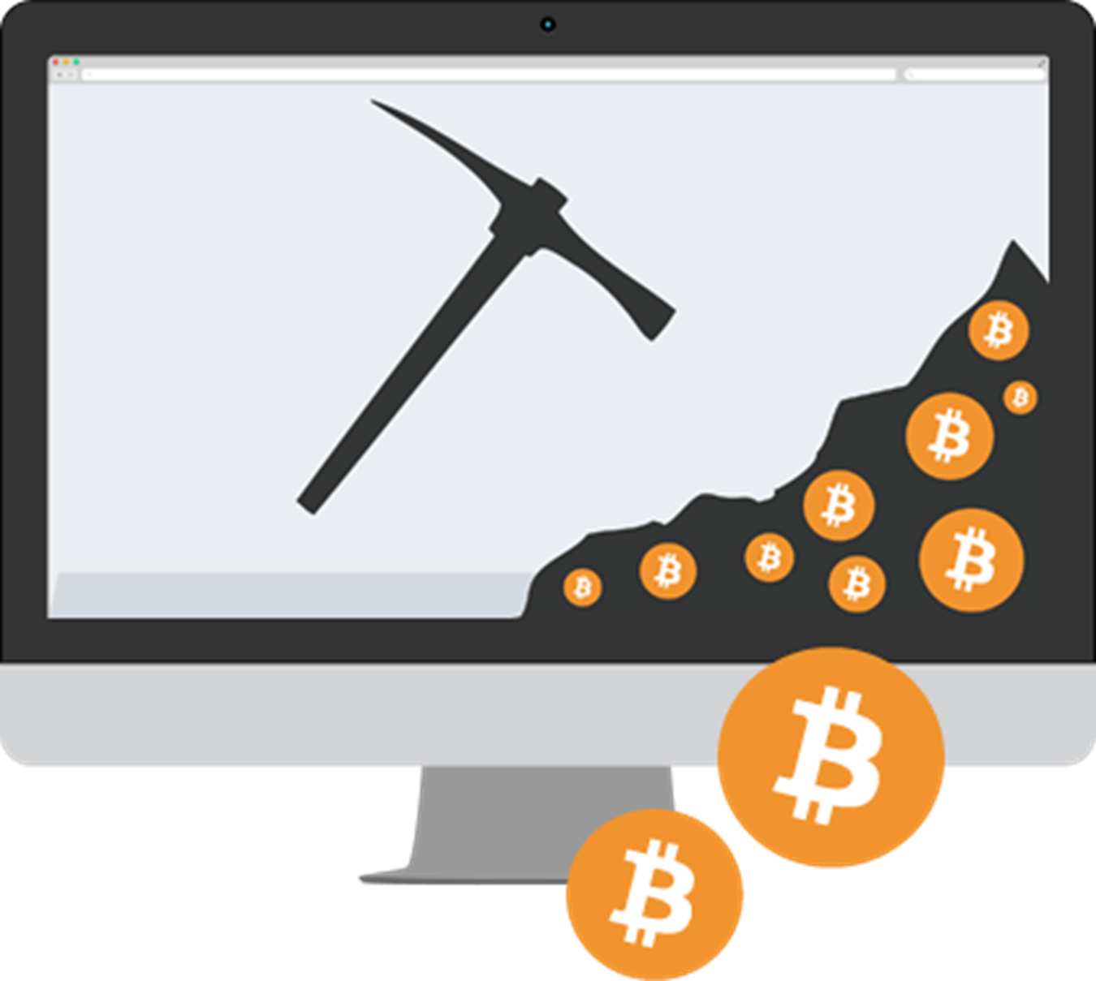
Mining

Slide 39
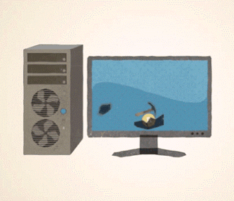
Mining..
How does miners work?
Special Software (Client) will be used to find the nounce. The client will work under the prescribed protocol set by the bitcoin community
First, when each time the transactions are taking place, the record of it is added to the tally list of Blockchain by the miners
After that, the miners check about the legal information of the coin like whether the person who has transacted it have the valid right to do this or whether the respected encrypted code of it is valid or not
After the successful validation the block will be added to the recent longest chain and the details are broadcasted.
Now all the miners will get the latest longest chain.

Slide 40
Blockchain.info

Slide 41
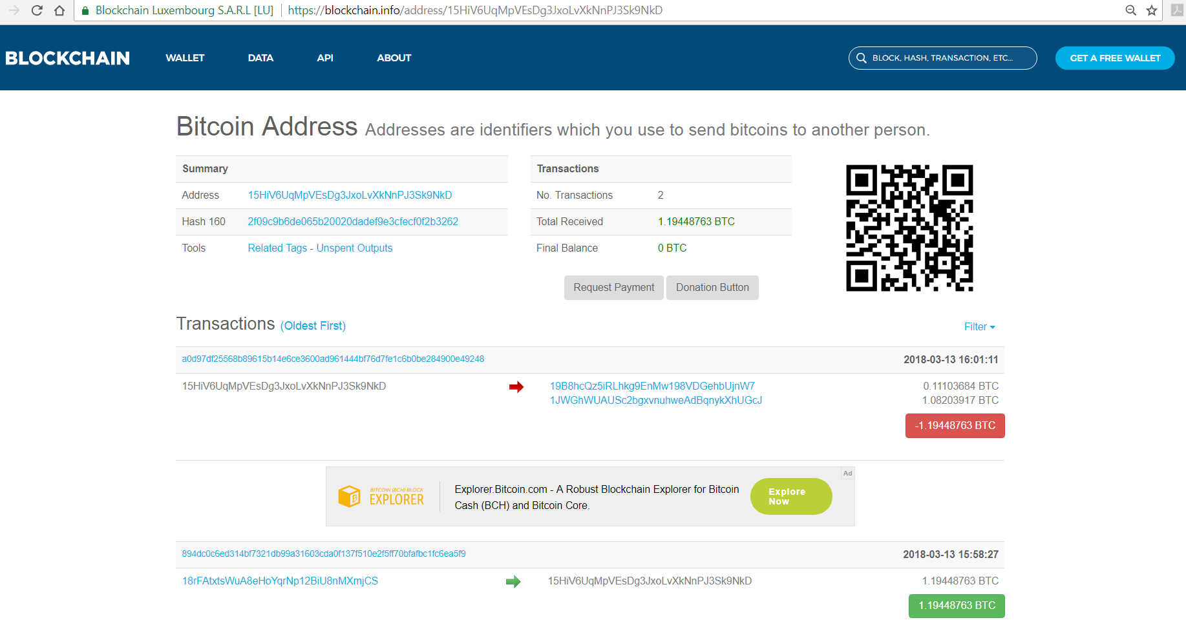
Blockchain.info

Slide 42
Bitcoin Client & Wallet

Slide 43
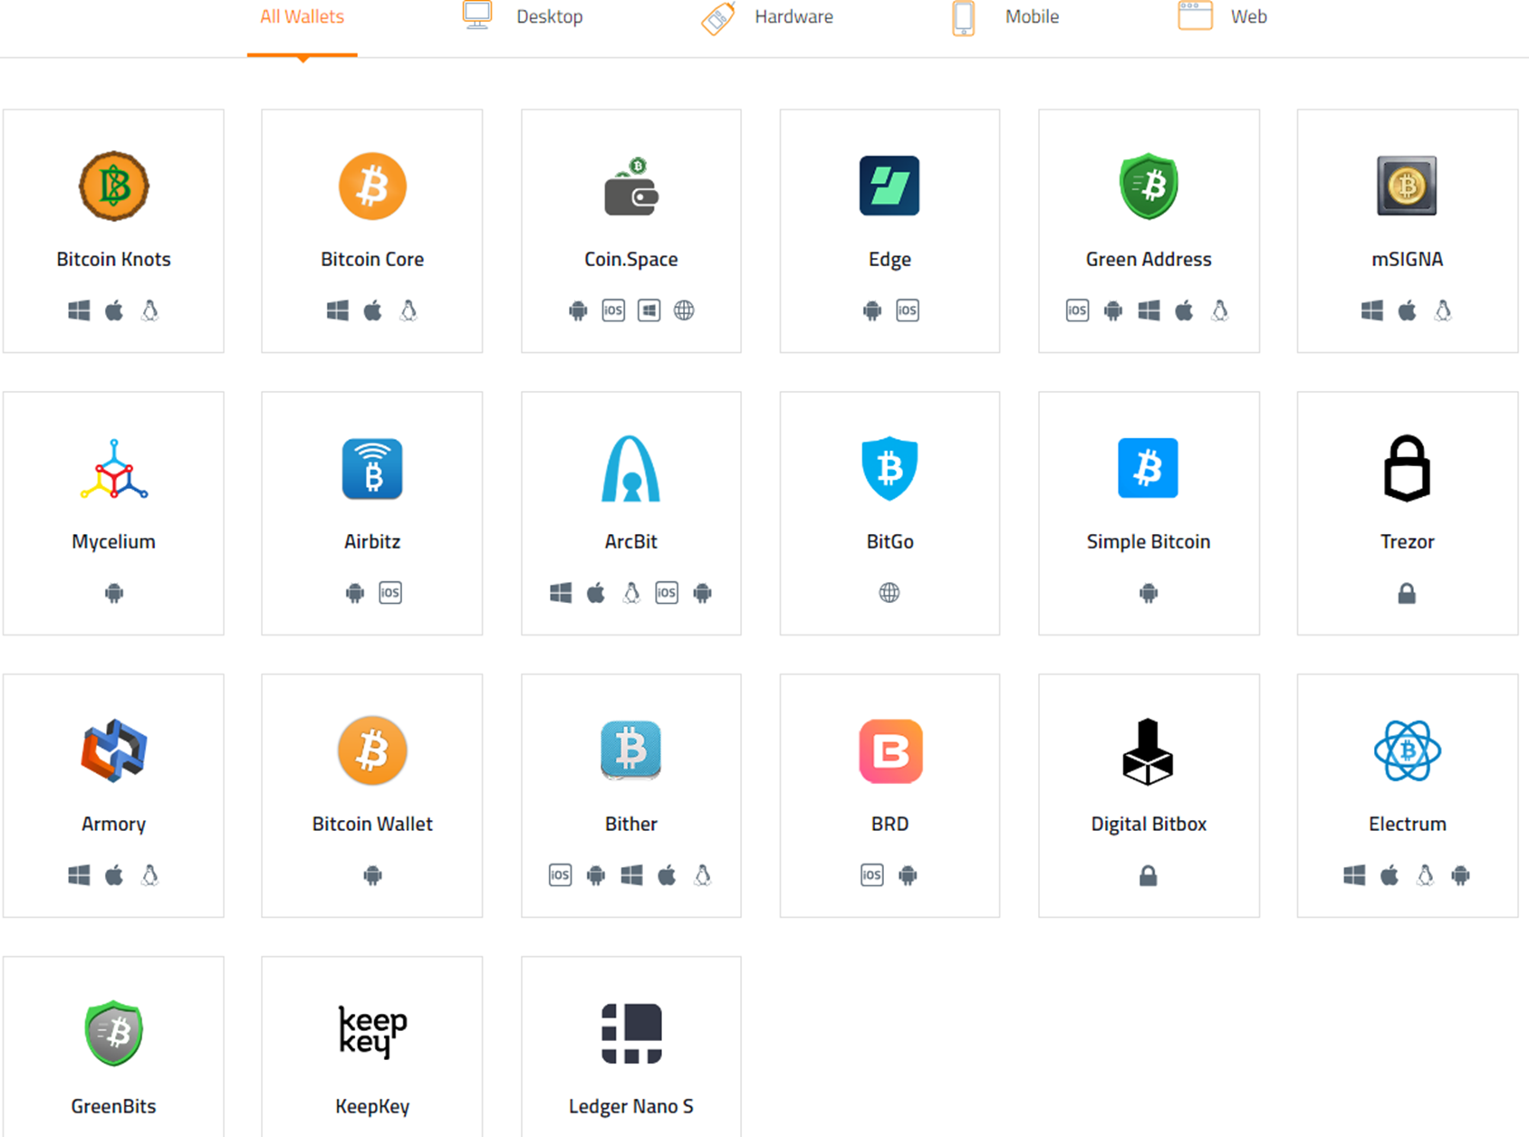
Bitcoin Client & Wallet

Slide 44
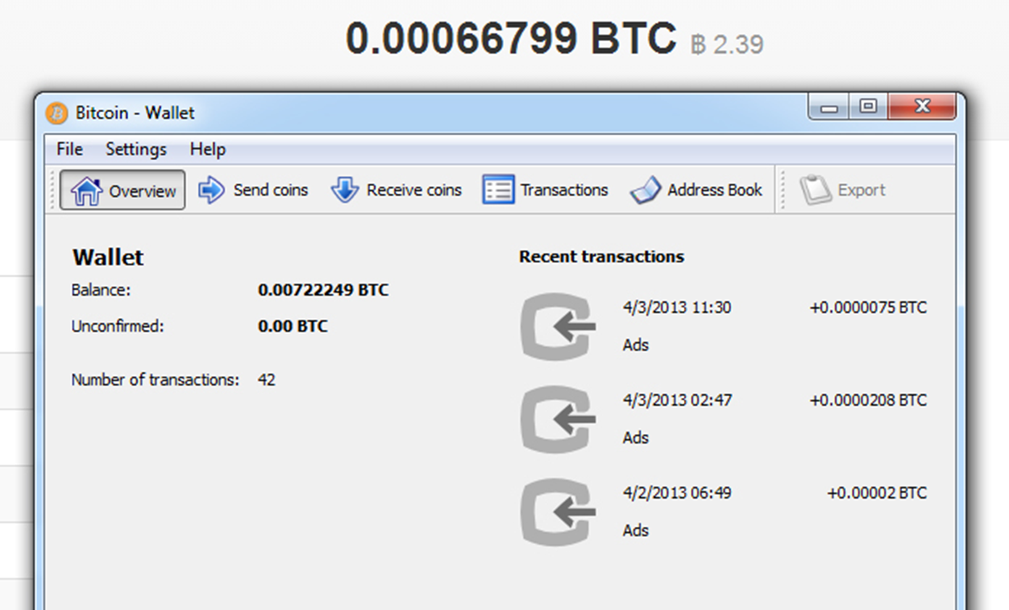
Bitcoin Client & Wallet

Slide 45

Bitcoin

Slide 46

What Is Bitcoin?
The first decentralized digital currency
Uses cryptography to control its creation and management, rather than relying on central authorities
They are created and held electronically in a peer to peer open ledger called the Blockchain
They are not printed. They are produced by people using software that solves mathematical problems

Slide 47

Comparing Bitcoin And Ethereum
Properties | Bitcoin | Ethereum
Concept | Digital money | World Computer
Cryptocurrency Token | BTC | Ether
Scripting language | Turing incomplete | Turing complete
Consensus Algorithm | SHA256 | Ethash
Coin Release Method | Early mining | Through ICO
Average block time | ~10 minutes | ~12-15 seconds

Slide 48
History of Bitcoin
Bitcoin.org registered by “Satoshi Nakamoto”
“Bitcoin: A peer-to-peer Electronic Cash System” paper posted in October
2008
Satoshi mines :genesis block” of 50 BTC in January
Bitcoin v0.1 released on cryptography @metzdowd.com and Usenet
First bitcoin transaction, #bitcoin-dev on Freenode, v0.2 released
2009
First offline transaction: 10K BTC for two pizzas
V0.3 announced, Slashdotted, Mt Gox founded-july
First specialized GPU hash miners and pooled mining operations
2010
Bitcoin takes parity with US Dollars
$31 top of first “bubble”, followed by the first price drop
Dec: $2, minimum after few months
2011
2012
Dec: $13, slowly rising for a year

Slide 49
History of Bitcoin..
Silk Road busted, arrests for money laundering
November: Bitcoin breaks $1,000 in second bubble
December 2013: Price crashes to $600
2013
Price fell following the shutdown of MTGOX
Price continued to fall due to a false report regarding Bitcoin ban in China
Now (April) stabilizing at $450
2014
Price fell through to early 2015.
Large spike in value from 225–250 at the start of October to the 2015 record high of $504.
2015
Large spike in value starting from $450 and reaching a maximum of $750
Price stabilized in the low $600 range
As the As the Chinese Renminbi depreciated against the US Dollar, bitcoin rose to the upper $700s. Renminbi depreciated against the US Dollar, bitcoin rose to the upper $700s
2016
Price fell 30% in a week, reaching a multi-month low of $750
Price broke above the November 2013 high of $1,242 and then traded above $1,290
Price reached its maximum in the history of bitcoin. Reached an all-time high of over $2,500 on the 25th
2017

Slide 50
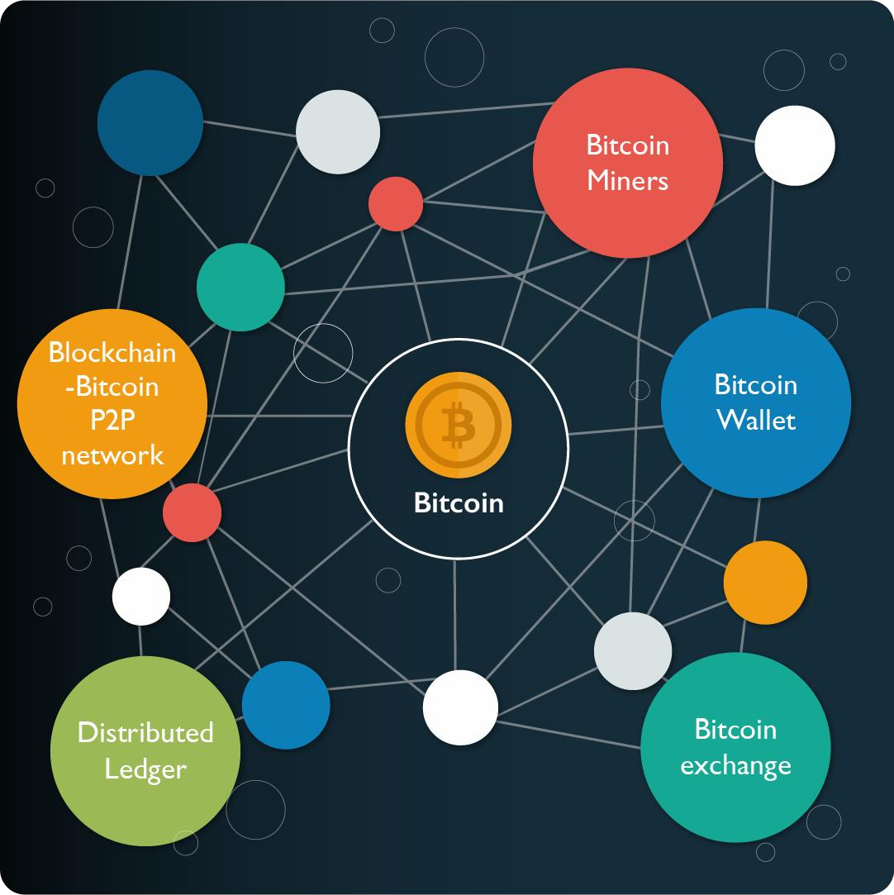
Bitcoin Ecosystem

Slide 51










Why use Bitcoins?
It’s Fast
Transactions are instantaneous if they are “zero confirmation” transactions, Or, they can take around 10 minutes is a merchant requires confirmation
Payment Security
Transactions don’t require you to give up any secret information. They use two key: Public key, and a private one
.
It isn’t inflationary
Only 21 million will ever be created under the original specification. So inflation won’t be a problem
It’s Cheap
Bitcoin transaction fees are minimal, or in some cases free
Our Strategy
It’s Decentralized
Because the currency is decentralized, you own it. No central authority has control
It’s Private It’s like having a clear plastic wallet with no visible owner. Everyone can look inside it, but no one knows
whose it is
No Chargebacks
Once bitcoins have been sent, they’re gone. A person who has sent bitcoins cannot try to retrieve them without the recipient’s consent
.
Create your own Money
You can certainly buy bitcoins on the open market, but you can also mine your own if you have enough computing power

Slide 52
Why use Bitcoins?
No Third-Party Seizure
Since there are multiple redundant copies of the transactions database, no one can seize bitcoins. The most
someone can do is force the user, by other means, to send the the bitcoins to someone else.
No Tracking
Unless users publicize their wallet addresses publicly, no one can trace transactions back to them. No one, other than the wallet owners, will know how many Bitcoins they have. Even if the wallet address was publicized, a new wallet address can be easily generated.
Bitcoins Cannot be Stolen
Bitcoins’ ownership address can only be changed by the owner. No one can steal Bitcoins unless they have physical access to a user’s computer, and they send the bitcoins to their account.

Slide 53

Where & How to buy Bitcoins
Let’s see how Bitcoins can be bought

Slide 54
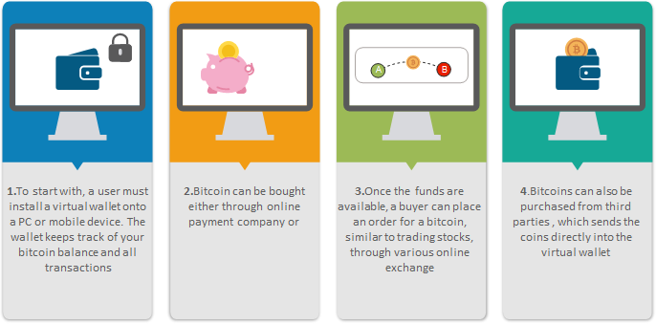
How do you buy a Bitcoin?

Slide 55
Getting Started With Bitcoin
Now, to buy or sell a bitcoin, customer has to join the network

Slide 56

Bitcoin Clients
To join a bitcoin network and start using the currency, all a user has to do is download an application or use a web application.
Full Client
Stores the entire history of bitcoin transactions manages the users' wallets, and can initiate transactions directly on the bitcoin network
Web Client
Web clients are accessed through a web browser and store the user’s wallet on a server owned by a third party
Lightweight Client
Stores the user’s wallet but relies on third-party–owned servers for access to the bitcoin transactions and network

Slide 57

Mobile Clients
Mobile clients are another popular form of Bitcoin client
Mobile clients for smartphones, such as those based on the Android system, can either operate as full clients, lightweight clients, or web clients. Some mobile clients are synchronized with a web or desktop client, providing a multiplatform wallet across multiple devices but with a common source of funds.

Slide 58
Popular Bitcoin Wallets
There are various Bitcoin wallets or clients available in the market, let’s have a look at the types of bitcoin wallets

Slide 59






Types of Bitcoin Wallets
Web-Wallets
Web-wallets are websites or even online exchanges that allow storage.
Example-Blockchain.info, Greenaddress, Coinbase, Coinbase vault storage
Mobile Wallets
A smartphone wallets makes it really easy to scan QR codes to make quick payments
Example: Breadwallet, Mycelium, AirBitz, GreenBits
Desktop Wallets
Apps installed on a desktop computer or laptop.
Example: Electrum, Multibit, Armory
Hardware Wallets
A piece of hardware is used to store the private keys to your bitcoins.
Example: Ledger Nano, Trezor
Paper Wallets
It is the most secure cold-storage solution
Example: Coindesk, Bitadress
Multi-signature Wallets
These wallets require multiple private key signatures to make a transaction
Examples: CarbonWallet, Coinbase, Blocktrail, electrum, CoinKite

Slide 60







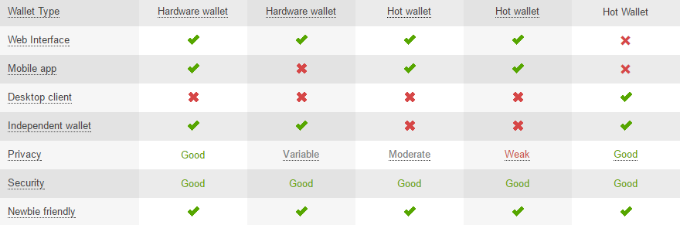
Different types of Bitcoin Wallets
Ledger Nano
Trezor
Trezor
Blockchain
Exodus

Slide 61







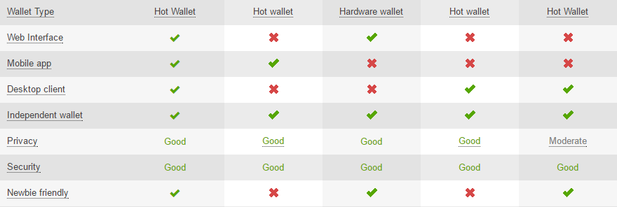
Different types of Bitcoin Wallets..
Jaxx
Mycelium
Keep key
Bitcoin
MultiBit

Slide 62
Comparing each Wallet type
Wallet Type | Safety | Beginners | Convenience | Cost
Web | Unsafe | Easy | Very convenient | Free
Mobile | Unsafe | Easy | Very convenient | Free
Desktop | Safe | Average | Average | Free
Hardware | Very safe | Average | Not convenient | 90-400 USD
Paper-Wallet | Very safe | Difficult | Not convenient | Usually free
Multi- Sig | Safe | Difficult | (variable) | Free

Slide 63

Jaxx Wallet
Now that we have discussed and compared various Bitcoin wallets, let’s see an example of a popular Bitcoin wallet

Slide 64
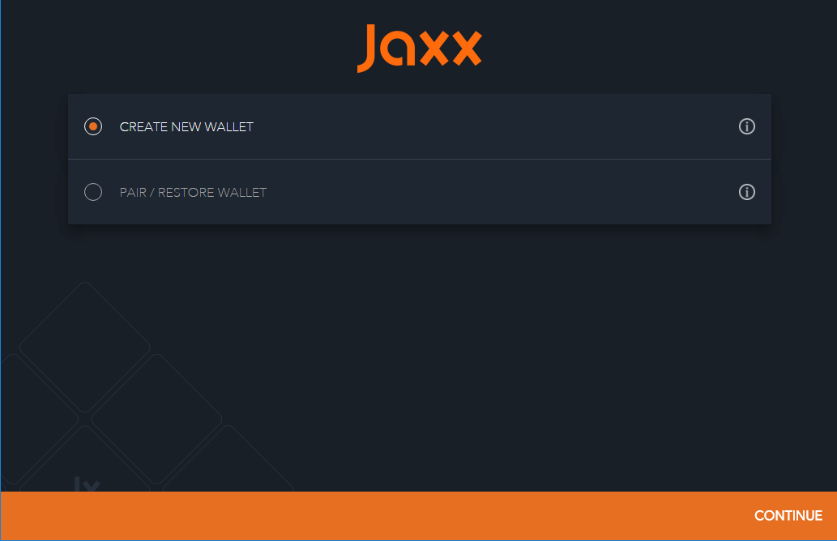
Jaxx Bitcoin Wallet
Jaxx wallet Screen

Slide 65
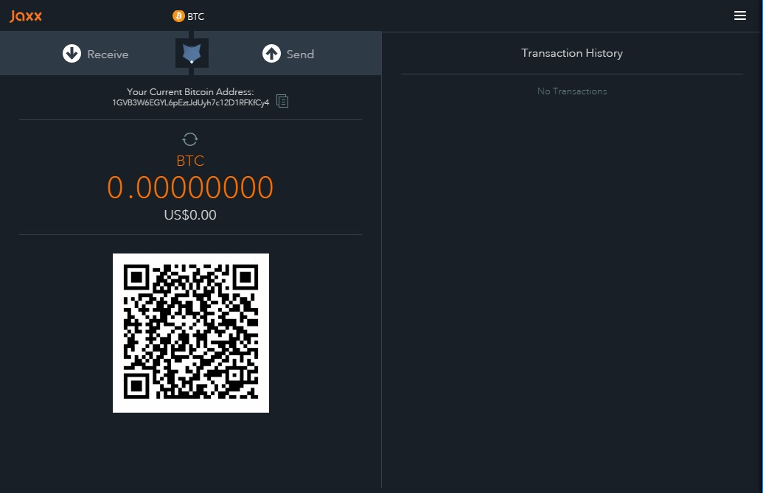
Jaxx Wallet Screen
Button to receive Bitcoins
Button to send Bitcoin
This scanner code can be used by the mobile clients to send you the Bitcoin

Slide 66
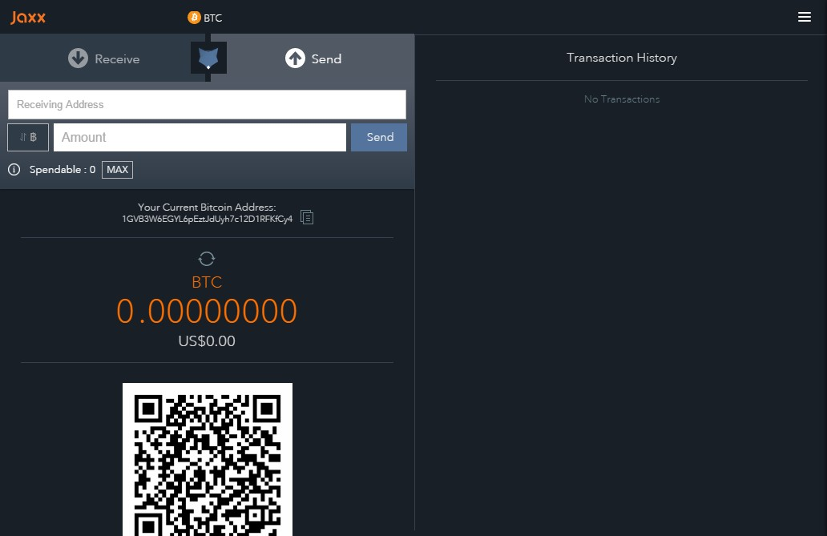
Sending Bitcoins from Jaxx Wallet
Step 2
Step 1
Step 4
Step 3

Slide 67
Steps for Sending Bitcoins
For sending Bitcoin through Jaxx wallet, consider the following steps:
Step 1: Select the send button
Step 2: In the address section, insert the Bitcoin address of the person you wish to send the Bitcoin
Step 3: In the amount column, write the amount of Bitcoins you want to send
Step 4: Click on the send icon (in blue)

Slide 68
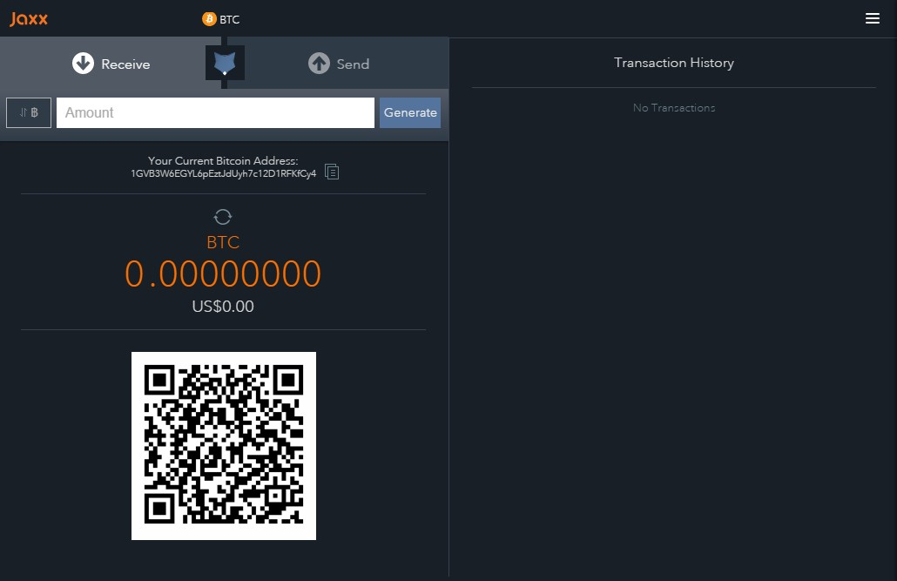
Receiving Bitcoins through Jaxx Wallets
Step 1
Step 2
Step 3

Slide 69
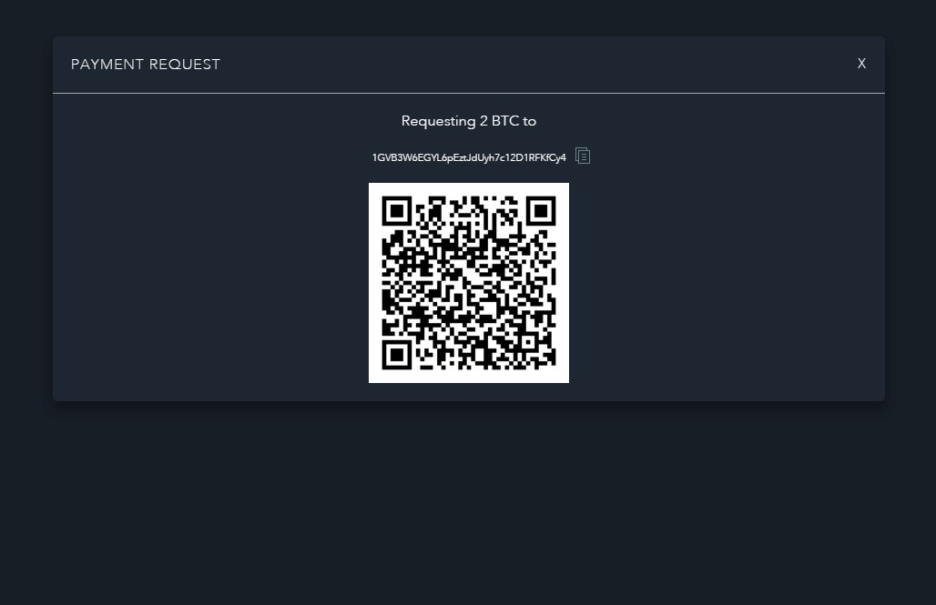
Receiving Bitcoins through Jaxx Wallets( Contd…)
Step 4

Slide 70
Steps for Receiving Bitcoins
Following are the steps to receive Bitcoins:
Step 1: Click on the ‘receive’ button
Step 2: In the ‘amount’ section, write the number of Bitcoins you want to receive
Step 3: Click on the ‘generate’ button
Step 4: Now you are ready to receive the amount of bitcoins by scanning the QR code

Slide 71






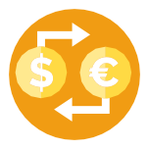
Where to find Bitcoins?
ATM
Private and easiest way to acquire Bitcoins Companies like Lamassu produce ATM-machines for bitcoins, where you can buy bitcoin with cash
Gift Cards
You can buy a gift card or a voucher, visit a website, where you can use the code on the card to get your Bitcoin
Exchanges
There are specialized currency exchanges where you can buy and sell bitcoin in exchange for a local currency. These operate as web-based currency markets. Example- Bitstamp & Coinbase
P2P- Markets
Buyers and sellers of Bitcoin meet and trade with each other. Bitsquare is a completely decentralized
market

Slide 72






How to Secure your Wallet
There are several ways to make your bitcoin wallet more secure:
Encrypt it
To protect your wallet from prying eyes is to encrypt it with a strong password. This makes it difficult to access your wallet, but not impossible
Encrypt
To protect your itwallet from prying eyes is to encrypt it with a strong password. This
makes it difficult to access your wallet,
but not impossible
Use Multi-sig
allow multiple parties to partially seed an address with a public key. The
required number of signatures is agreed at
the start when people create the address.
Use Multi-sig
Allow multiple parties to partially seed an address with a public key. The
required number of signatures is agreed at the start when people create the address
Back it up
Backing up your wallet makes a copy of your private keys, but it's important to back up your whole wallet
Take it offline
Cold storage wallets store private bitcoin keys offline, so that they can’t be stolen by someone else on the Internet.
Back it up
Backing up your wallet makes a copy of your private keys, but it's important to back up your whole wallet.
Take it offline
Cold storage wallets store private bitcoin keys offline, so that they can’t be stolen by someone else on the Internet

Slide 73




Getting your first Bitcoins
It is still quite difficult to acquire bitcoins in most countries. Currency exchanges is the easiest way to buy bitcoins
A European currency market that supports several currencies including euros (EUR) and US dollars (USD) via wire transfer
A US-based bitcoin wallet and platform where merchants and consumers can transact in bitcoin
Zebpay is the fastest and easiest way to Buy and Sell Bitcoins in India
Coinsecure is the most secure Bitcoin exchange to buy, sell & accept Bitcoins

Slide 74


Best Payment Method to get Bitcoins
Payment Method | Average Fees | Anonymity | Speed to Purchase | Overall Difficulty
Credit Card | High | Not Great | Very Fast | Easy
Bank Transfer | Very low | Not Great | Slow | Easy/Medium
PayPal | Very high | Good | Fast | Medium
Cash | Low | Excellent | Slow | Medium
Work for it (Mining) | No fees | Good | Slow | Hard

Slide 75



Characteristics that Qualify a Good Bitcoin Exchange
Community Interaction
Exchanges don’t exist in a void, and those that are reaping all reward without giving something back really don’t deserve your custom.
Security
Bitcoin exchanges do themselves get hacked, so it is important to choose an exchange with good security
Payment Methods
No site accepts all four of the most-used payment methods: Bank transfer, credit card, PayPal, cash. Do check out for the
payment methods
Customer Service
It’s good to research each site’s customer service records before depositing
06
03
Ease of Use Don’t try use a decentralized exchange if this is your first day on Bitcoin, choose a site that
accommodates beginners
Commissions & Fees
Paying the cheapest fees is always important
check for the fees before you deposit money anywhere

Slide 76
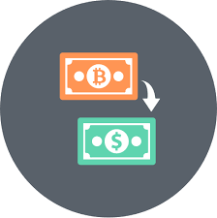
How to Sell Bitcoins
First you need to consider which method best suits your situation:
Selling Bitcoins Online
Selling Bitcoins in Person

Slide 77




Selling Bitcoins
There are three ways to go about selling bitcoin online
Involves a direct trade with another person, an intermediary facilitating the connection
Involves an online exchange, where your trade is with the exchange rather than another individual
Exchange Trades
Allow bitcoin owners to obtain discounted goods with their bitcoin via others that want to obtain the cryptocurrency with credit/debit cards

Slide 78
Selling of Bitcoins
Online:
Websites that offer this type of selling structure include Coinbase and LocalBitcoins in the US, and BitBargain
UK and Bittylicious in the UK
Peer to Peer:
A new development in the bitcoin space is the advent of sites like Brawker and Purse, which set out to bring together two groups of people with specific and complementary needs
The marketplace acts as an intermediary, offering users the platform, bitcoin wallet and escrow for
transactions

Slide 79
Selling Bitcoin in person
The easiest way to pass on your digital currency
Simply scan a QR code on another person’s phone and collect your cash from them
There are several points to be aware of when selling Bitcoin in person
Agree on price
Decide on a rate works for
you
Use a price from a prominent Bitcoin exchange
Stay Safe
It is always wise when carrying a large amount of cash to meet in a public place and/or go with a friend.
LocalBitcoins
You could advertise yourself as a Bitcoin seller to a wider audience. The definitive site for this is LocalBitcoins.

Slide 80
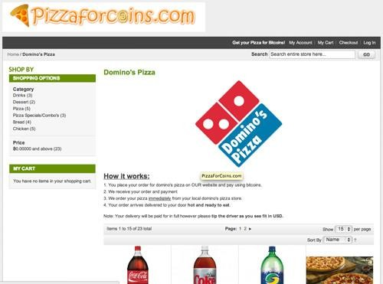

Places to Spend Bitcoins
Allows you to order from any nearby Domino’s, Pizza Hut or Papa Johns. Pay in Bitcoins to PizzaForCoins
Provides high-quality medicine, both branded and generic. It accepts Bitcoins alongside traditional money, and will ship worldwide

Slide 81
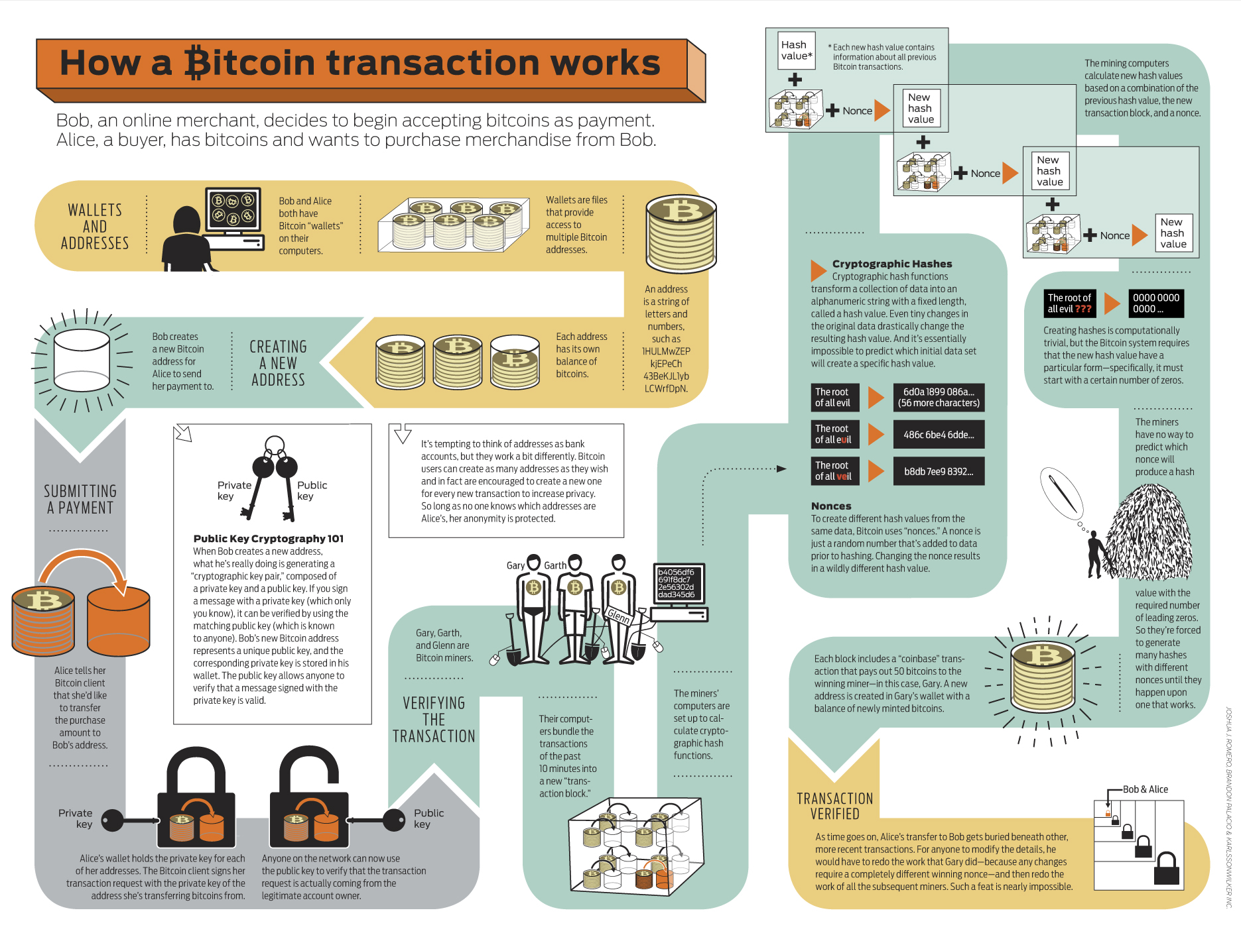

Slide 82
Use Cases in Blockchain

Slide 83

Potential Blockchain Use-Cases
Gold
Example: Real Asset co. in London
Example: MeXBT in Mexico city provides a web-based app
Remittances
Syndicated Loans
Example: Digital Asset Holdings,
Master’s firm
Private Shares
Example: NASDAQ is developing a Blockchain based system
Example: London start-up Everledger uses 4.0
Diamonds
Example: Factom based in Austin, Texas is building a Land title registry
Property titles/Land
records
US Treasury Repos
Example: NASDAQ is developing a Blockchain based system
Example: London based Earthport and Ripple labs a Sanfransisco based start-up
Interbank Payments
Airline Miles
Example: Chain, a San Francisco Firm, offers software tools for developers

Slide 84
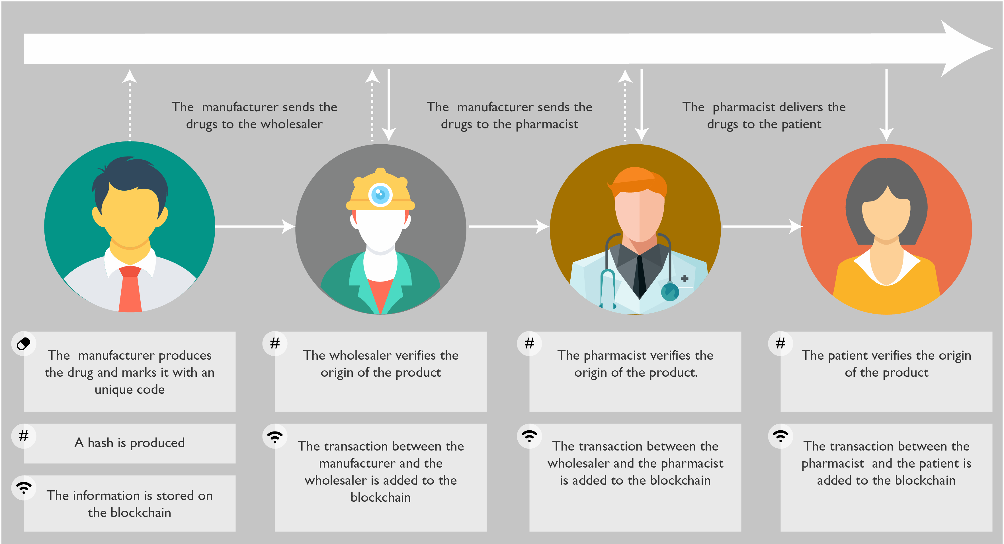
Use Case 1: Drug Traceability
The transaction between the manufacturer and the wholesaler is added to the Blockchain
The transaction between the wholesaler and the pharmacist is added to the Blockchain
The transaction between the wholesaler and the patient is added to the Blockchain
The information is stored on the Blockchain

Slide 85

Use Case 2: Patient Data Management: Issues
When it comes to patient data management, there are two main issues in the healthcare industry
First, each patient is unique therefore access to complete medical records is essential in order to adapt the treatment and provide personalized care
Second, sharing information among the medical community is a major challenge

Slide 86

Use Case 2: Patient Data Management: Solution

Slide 87
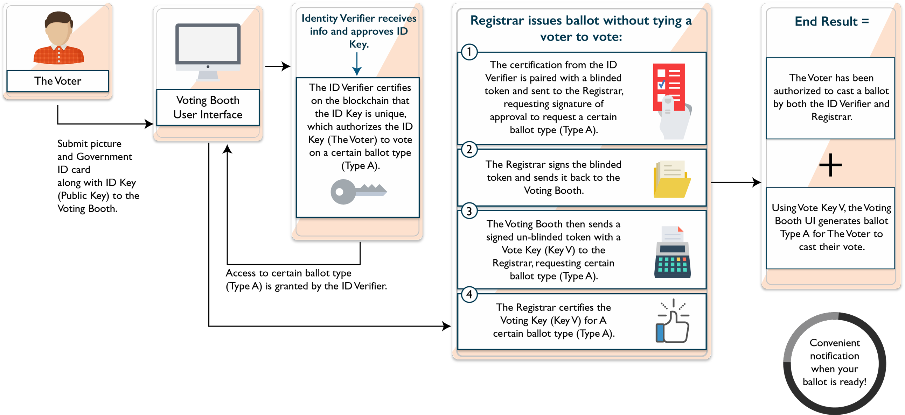
Use Case 3: Follow My Vote

Slide 88











Blockchain Use Cases For Banking
In banking there are many existing and developing use cases to implement Blockchain.
Following are the use cases we will be discussing:
Payments
1 2
KYC
Because it does not require manual processing, nor authentication through intermediaries
KYC can be performed on a universal Blockchain network so that once a person is done with his KYC he doesn’t have to do it all over again for some different platform
3
4
Reduction of frauds
Publicly available data is constantly scrutinized in real time for verification. This mechanism could be used on Blockchain to provide evidence of lawful and regulated running of banks
Trading Platforms
A potential new medium to exchange assets without intermediaries and without the risk of double spending

Slide 89
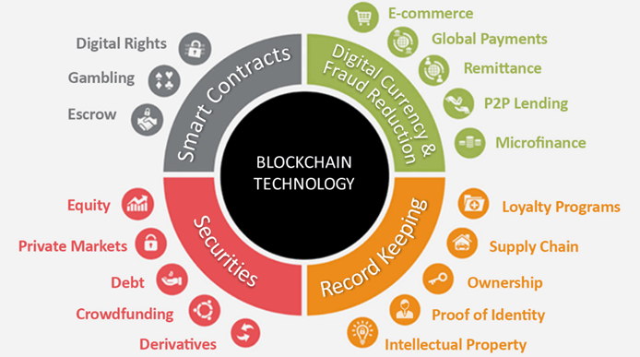
Blockchain Use Cases across various Domains

Slide 90
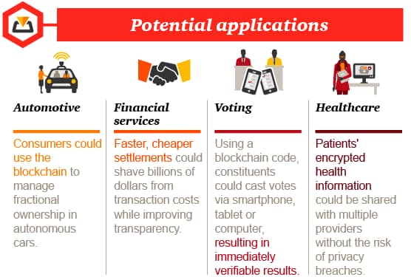
Real World Use Cases of Blockchain

Slide 91

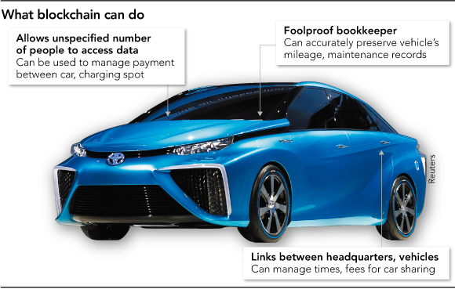


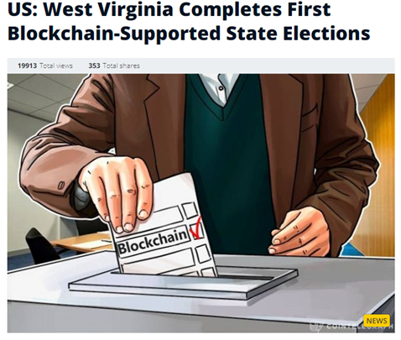
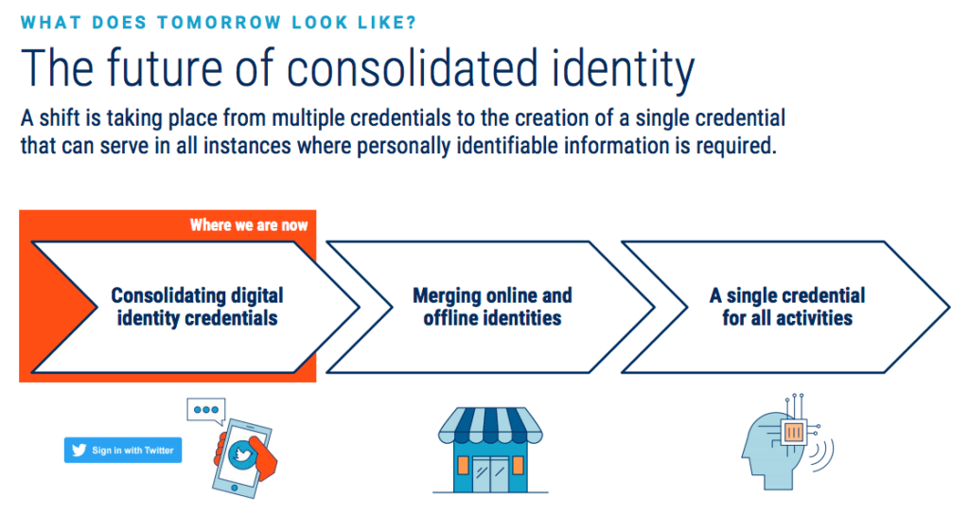
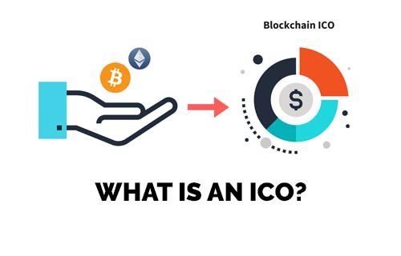

Slide 92


Copyright © 2017, edureka and/or its affiliates. All rights reserved.

Slide 93
Blockchain – Self Questionnaire
Who invented Blockchain ?
What problems can be solved by Blockchain ?
Who is creating the Blockchain ?
How important is Blockchain?
How Blockchain works ?
Blockchain is a software ?
Where to learn this hot technology ?
is it a trending technology ?
Career opportunity ?
Any prerequisites for learning Blockchain ?

Slide 94
Blockchain – Self Questionnaire
What is the principle on which Blockchain technology is based on?
It enables the information to be distributed among the users without being copied.
Why is Blockchain a trusted approach?
Blockchain can be trusted due to so many reasons:-
Its compatibility with other business applications due to its open-source nature.
Its security. As it was meant for online transactions, the developers have paid special attention to keeping up the pace when it comes to its security. It really doesn’t matter what type of business one owns, Blockchain can easily be considered.
Name the two types of records that are present in the Blockchain database?
These records are block records and transactional records. Both these records can easily be accessed, and the best thing is, it is possible to integrate them with each other without following the complex algorithms.

Slide 95

Blockchain – Self Questionnaire
What is encryption? What is its role in Blockchain?
Data security always matters. Encryption is basically an approach that helps organizations to keep their data secure.
The encrypted data is encoded or changed up to some extent before it is sent out of a network by the sender and only authorized parties can access that information. In Blockchain, this approach is useful because it simply adds more to the overall security and authenticity of blocks and helps to keep them secure.
What do you mean by blocks in the Blockchain technology?
Blockchain consists of a list of records. Such records are stored in blocks. These blocks are in turn linked with other blocks and hence constitute a chain called Blockchain.

Slide 96
Blockchain – Self Questionnaire
How a block does is recognized in the Blockchain approach?
Every block in this online ledger basically consists of a hash pointer which acts as a link to the block which is prior to it, transaction data and in fact a stamp of time.
Is it possible to modify the data once it is written in a block?
No, it’s not possible to do so. In case any modification is required, the organization simply has to erase the information from all other blocks too. It is because of no other reason than this, data must be given the extreme care of while using this approach.
What are Block Identifiers?
In Blockchain, blocks can be identified by the block header hash and the block height.
Is it possible in Blockchain to remove one or more block from the networks?
Yes, it can be done. There are times when only a specific portion of this online ledger is to be considered. With the help of default options and filters, this can easily be done without making a lot of efforts.

Slide 97
Blockchain – Self Questionnaire
What exactly do you know about the security of a block?
Well, a block or the entire Blockchain is protected by a strong cryptographic hash algorithm. Each block has a unique hash pointer. Any modification in the block constituents will result in the change in the hash identifier of the block. Therefore, it offers an excellent level of security. Thus, one needs not to worry about the safety as well as the security of data that is present in a block.
What type of records can be kept in a Blockchain? Is there any restriction on same?
There is no restriction on keeping records of any type in the Blockchain approach. Industries are using Blockchain for securing all types of records.
The common types of records (to name a few) that can be kept on the Blockchain are:-
Records of medical transactions
Identity management
Transaction processing
Business transactions,
Management activities
Documentation

Slide 98
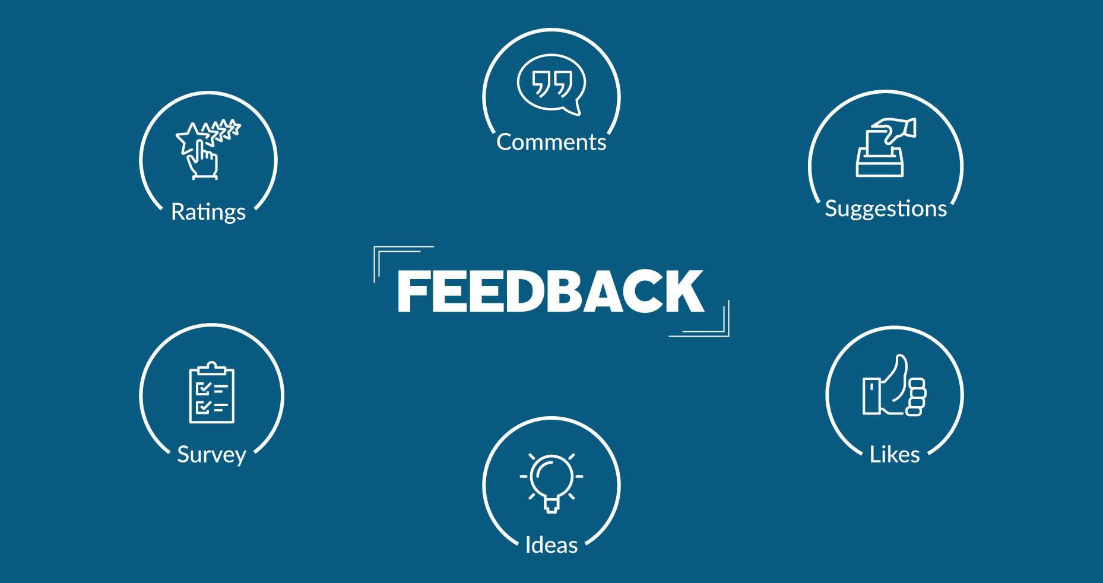
Copyright © 2017, edureka and/or its affiliates. All rights reserved.

Slide 99
